Slide 1
Should I Refer This Bilingual Student for a Speech-Language Evaluation?
A Presentation for the Awesome Teachers at This School

Slide 2
The important question to answer
Are the patterns I am worried about due to an influence from the student’s native language?
Speech sounds
Language patterns
Syntax (word order)
Morphology (word endings)
Semantics (word selection)
Pragmatics (social customs)

Slide 3
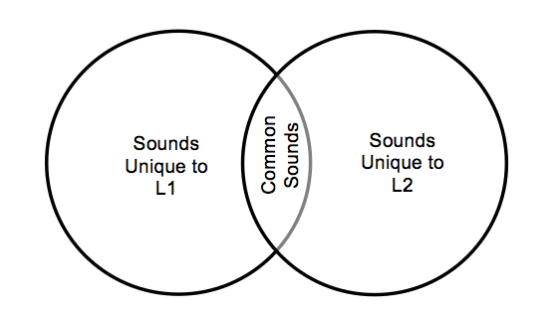
Speech Sounds vs. Unshared Sounds
Step 1
In order to know whether we should be concerned about a student’s speech production skills, we need to know what sounds are shared between their native language and the language they are in the process of acquiring.
Notes:
In order to know whether we should be concerned about a student’s speech production skills, we need to know what sounds are shared between their native language and the language they are in the process of acquiring.

Slide 4
\Speech Sounds vs. Unshared Sounds
Step 1
L1 is the student’s native language
L2 is the student’s second language – English
Notes:
The sounds on the left side (L1) are the sounds unique to the child’s native language that do not exist in the language they are learning.
The sounds on the right side (L2) are the sounds unique to the language the child is learning that do not exist in their native language.
The sounds in the middle of the Venn diagram are shared between the two languages.

Slide 5
Speech Sounds
Step 1
If the student makes errors only on sounds in this box, it’s an indication that their patterns are due to an influence from their native language
Notes:
Shared and unshared sounds/processes

Slide 6
Speech Sounds
Step 1
If the student makes errors on sounds in this circle (L1 sounds and sounds shared by L1 and L2), it’s an indication that you should consider referring them for an evaluation
Notes:
Shared and unshared sounds/processes

Slide 7
Spanish and English Speech Sounds
These diagrams use symbols from the International Phonetic Alphabet (IPA)
Guide to IPA sounds in English
tʃ = ch (chair)
j = y (yellow)
ð = voiced “th” (they)
dʒ = j (jump)
ŋ = ng (bring)
θ = unvoiced th (think)
ʃ = sh (share)
ʒ = zjuh (measure)
ɹ = r (red)

Slide 8
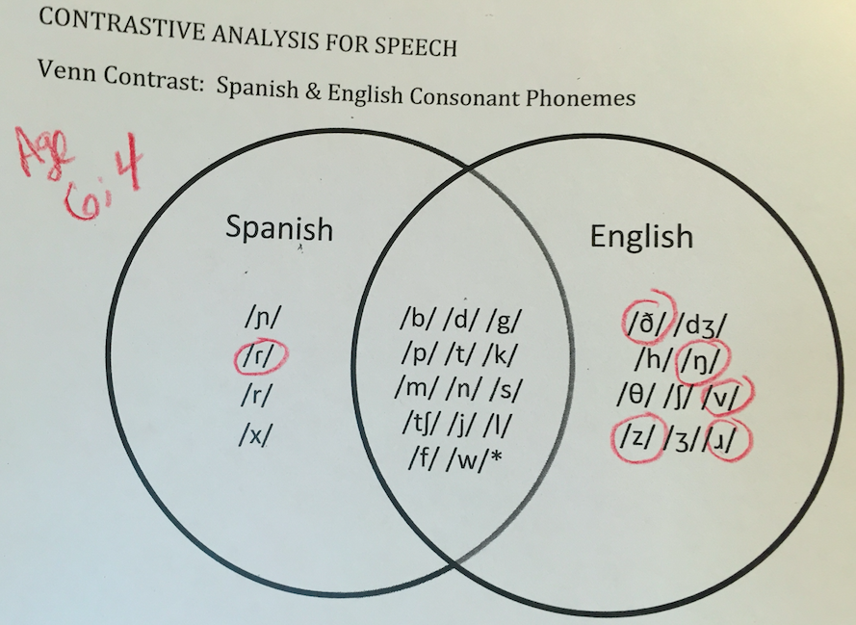
Here’s an example of a student who likely shouldn’t be referred for an evaluation. The only error in the zone of concern is the Spanish /r/, which the child could produce after it was modeled. It’s also a sound that children master a little later than other sounds.

Slide 9
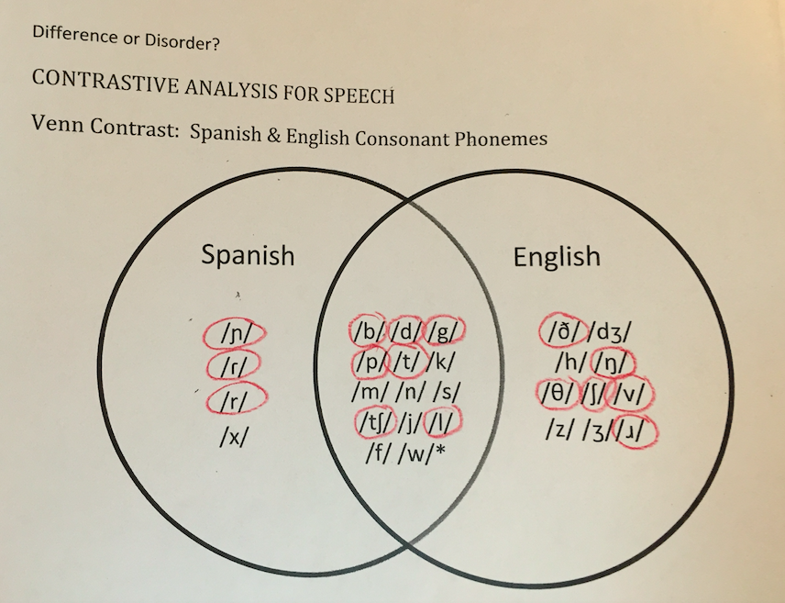
Here’s an example of a student who should be referred for an evaluation. This student is making errors on sounds in all three zones.
Age 6;4

Slide 10
Vietnamese Speech Sounds
These diagrams use symbols from the International Phonetic Alphabet (IPA)
Guide to IPA sounds in English
tʃ = ch (chair)
j = y (yellow)
ð = voiced “th” (they)
dʒ = j (jump)
ŋ = ng (bring)
θ = unvoiced th (think)
ʃ = sh (share)
ʒ = zjuh (measure)
ɹ = r (red)
ɹ

Slide 11
Mandarin Speech Sounds
These diagrams use symbols from the International Phonetic Alphabet (IPA)
Guide to IPA sounds in English
tʃ = ch (chair)
j = y (yellow)
ð = voiced “th” (they)
dʒ = j (jump)
ŋ = ng (bring)
θ = unvoiced th (think)
ʃ = sh (share)
ʒ = zjuh (measure)
ɹ = r (red)

Slide 12
Where can sounds occur in words?

Slide 13
Phonotactic Constraints

Slide 14
Now let’s talk about LANGUAGE How do speech-language pathologists think about language?
Semantics (word meanings)
Pragmatics (social use)
Language Form (word order/endings)
Receptive language
What we understand
Expressive language
What we say

Slide 15
Receptive Language
Children who are learning English as their second language may not understand everything when spoken to in English.
Use strategies that have been found to be helpful for children in the process of learning a second language
Repeat instructions at a slightly slower rate
Provide some visual support
Ask them to repeat instructions back to ensure they understood them
Teach vocabulary of the lesson in advance
Provide a structure of peer support
If these strategies are not helpful, a referral is appropriate

Slide 16
Expressive Language
Syntax
If the child uses words in the wrong order (e.g. the lake blue instead of the blue lake), check to see what the word order is in their native language.
If the child starts sentences with a verb, check to see if that is permissible in their native language.
If the child does not include a subject at the beginning of every sentence, check to see if that allowable in their native language

Slide 17
Expressive Language
Morphology
If the child struggles to add plural endings, check to see how plurals are marked in their native language.
If the child doesn’t include verb endings, check to see how verbs are marked (and if they are marked) in the child’s native language
If the child does not use ‘s to mark possession, check to see how possession is marked in the native language

Slide 18
Expressive Language
Semantics
Children learning two languages will often borrow words from one language to use in another. This is okay.
Key questions to ask
Do you know what they are talking about? If so, great
Does the child use a lot of non-specific words (e.g. this, thing, one, it) that makes it really difficult to know what they are referring to? If so, this might be a good referral.
Things to know about bilingual vocabulary
Bilingual children know different words in their different languages and only a portion of the words do they know in both languages
Bilingual children with typical development know words for the same number of concepts as their monolingual peers. They just might know them only in one language or the other

Slide 19
Expressive Language
Pragmatics (Social Language)
Different cultures communicate in different ways. Some things that can vary across cultures are:
Whether children make eye contact with unfamiliar adults
Whether children initiate communication with unfamiliar adults
What is a comfortable distance between two people communicating
Before you make a referral for behaviors that are “different,” find out if the differences are due to cultural variation

Slide 20
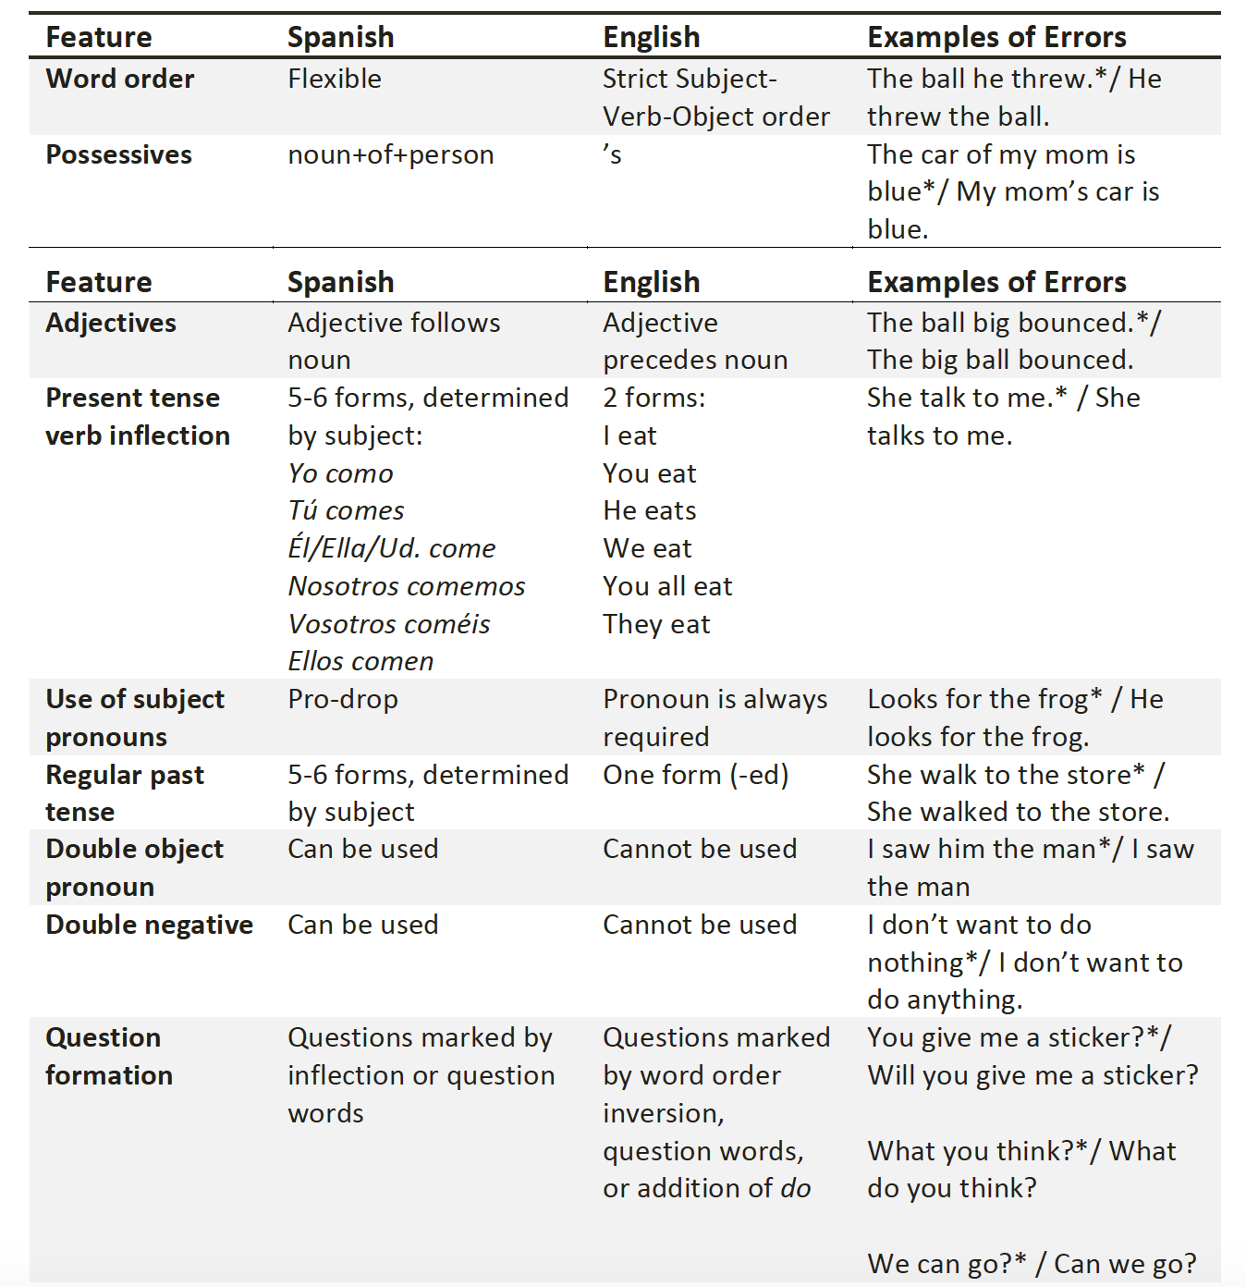
Influence Patterns
Spanish Language Features

Slide 21
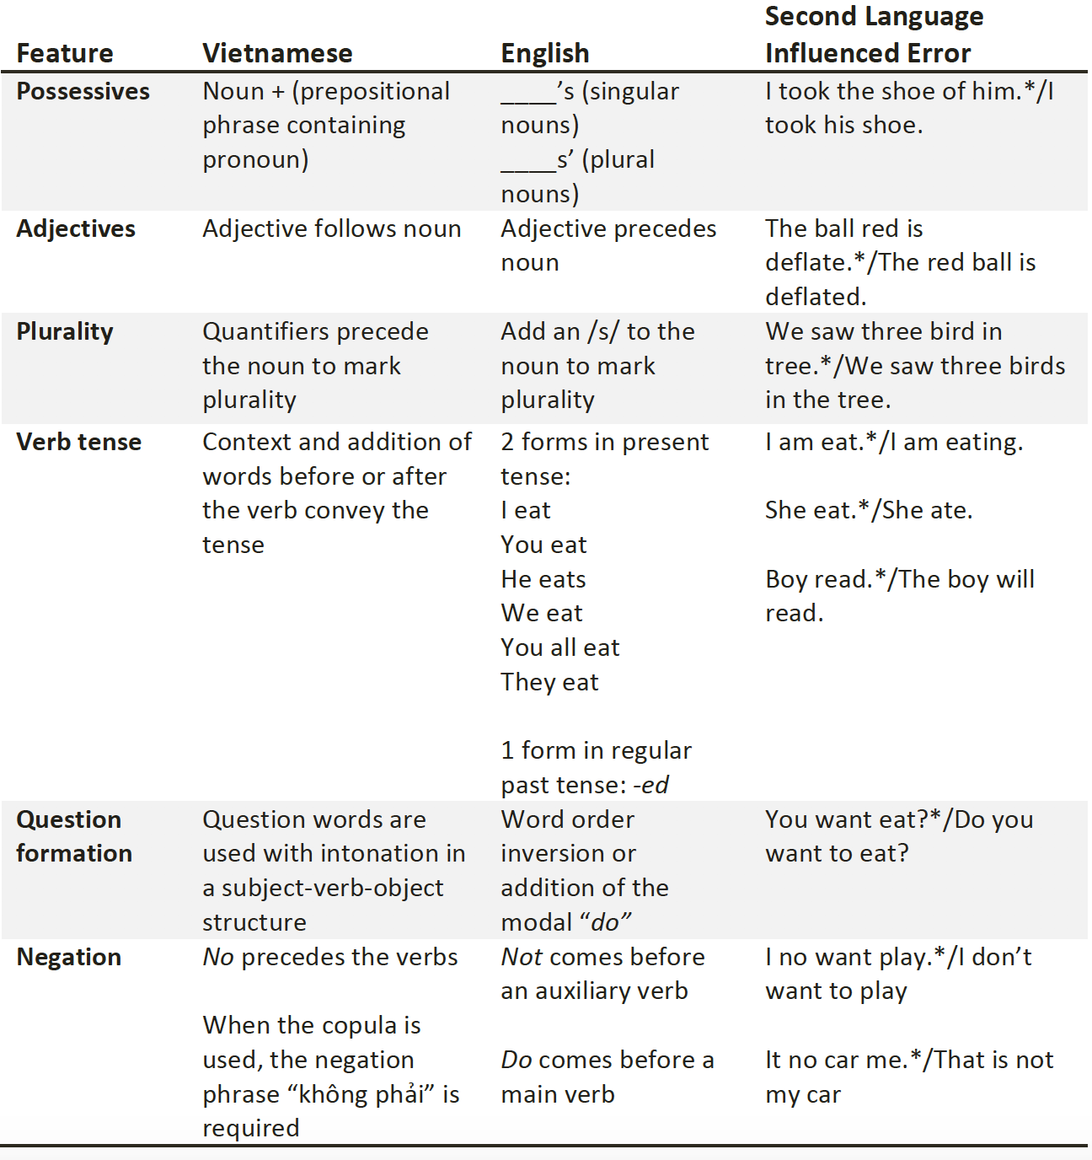
Influence Patterns
Vietnamese Language Features

Slide 22
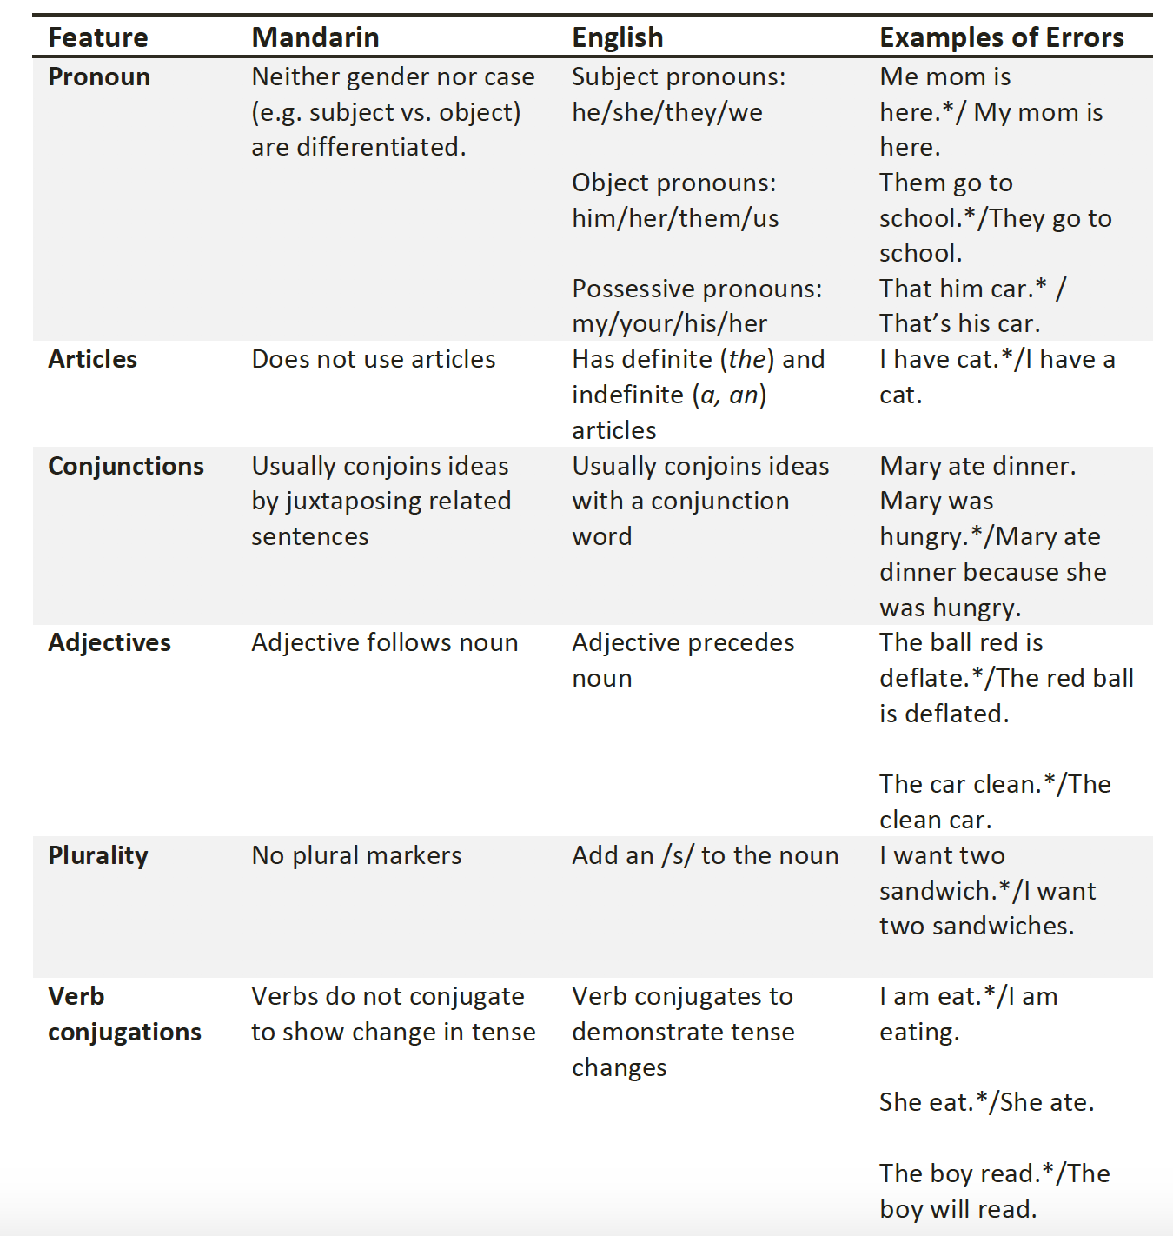
Influence Patterns
Mandarin Language Features

Slide 23
Let’s work together to be sure our students get the right support!

